Slide 1
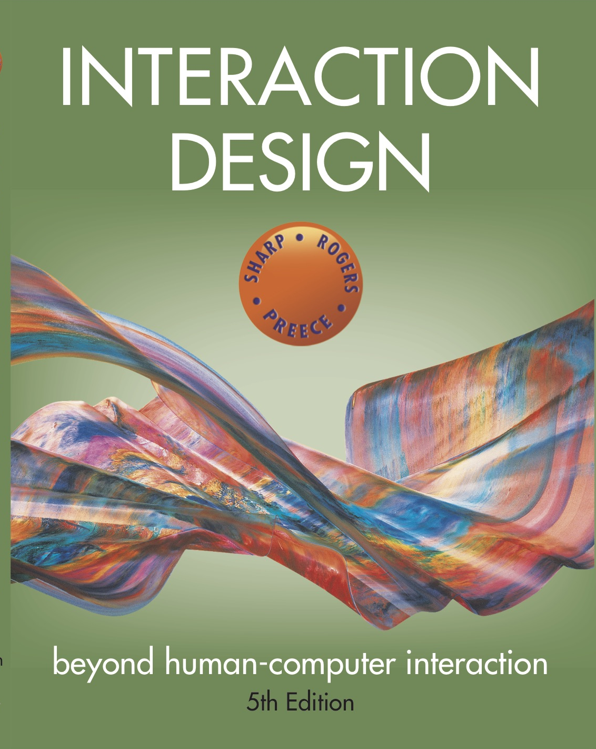
Chapter 3
CONCEPTUALIZING
INTERACTION DESIGN?

Slide 2
Conceptualizing design
Proof of concept
conceptualize what the proposed product will do
Why the need to conceptualizing design?
to scrutinize vague ideas and assumptions about the benefits of the proposed product in terms of their feasibility
how realistic is it to develop?
how desirable and useful?

Slide 3
Assumptions and claims
Write down your assumptions and claims when coming up with a new design
Try to defend and support them by what they will provide
Those that are difficult to articulate
can highlight what ideas are vague or unrealistic
identify human activities and interactivities that are problematic
Iteratively work out how the design ideas might be improved

Slide 4

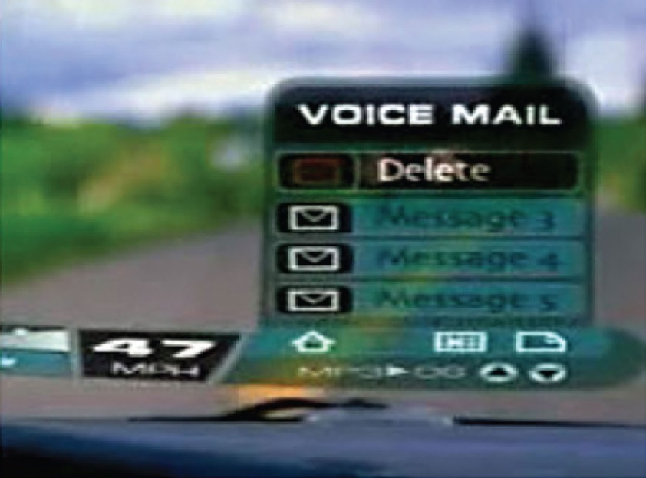
What is an assumption?
http://www.ibiblio.org/jlillie/cooltown/lillie.htm
Taking something for granted when it needs further investigation
e.g. people will want to watch TV while driving

Slide 5
What is a claim?
Stating something to be true when it is still open to question
e.g. “a multimodal style of interaction for controlling GPS — one that involves speaking while driving — is safe”
Notes:
Writing down your assumptions and claims and then trying to defend and support them can highlight those that are vague or wanting. In so doing, poorly constructed design ideas can be reformulated. Explicating people’s assumptions and claims about why they think something might be a good idea (or not) enables the design team as a whole to view multiple perspectives on the problem space and in so doing reveal conflicting and problematic ones.
5

Slide 6
Activity: How will enabling robot waiters to speak to customers enhance their experience?
Source: Xinhua/Guo Cheng, www.xinhuanet.com/english/2015-12/23/c_134945262.htm
Notes:
Discuss if this is true

Slide 7
What is the problem being addressed?
The benefits:
the robot could take orders and entertain customers by having a conversation with them
could make recommendations for different customers, such as restless children or fussy eaters
But just assumptions
The real problem being addressed:
“It is difficult to recruit good wait staff who provide the level of customer service to which we have become accustomed.”

Slide 8
Working through assumptions
Many unknowns need to be considered in the initial stages of a design project
where do your ideas come from?
What sources of inspiration were used?
Is there any theory or research that can be used to inform them?
During the early ideation process
ask questions, reconsider assumptions, and articulate concerns

Slide 9
A framework for analysing the problem space
Are there problems with an existing product or user experience? If so, what are they?
Why do you think there are problems?
How do you think your proposed design ideas might overcome these?
If you are designing for a new user experience how do you think your proposed design ideas support, change, or extend current ways of doing things?

Slide 10
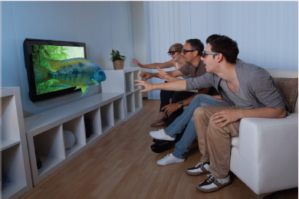
Activity
What were the assumptions and claims made about watching 3D TV?
Figure 3.2 A family watching 3D TV
Source: Andrey Popov/Shutterstock.com
Notes:
10

Slide 11
Assumptions and claims: how realistic?
There was no existing problem to overcome
what was being proposed was a new way of experiencing TV
An assumption
People would really enjoy the enhanced clarity and color detail provided by 3D
A claim
People would not mind paying a lot more for a new 3D-enabled TV screen because of the new experience
Notes:
11

Slide 12
Benefits of conceptualising
Orientation
enables design teams to ask specific questions about how the conceptual model will be understood
Open-minded
prevents design teams from becoming narrowly focused early on
Common ground
allows design teams to establish a set of commonly agreed terms

Slide 13
From problem space to design space
Having a good understanding of the problem space can help inform the design space
e.g. what kind of interface, behavior, functionality to provide
But before deciding upon these it is important to develop a conceptual model
Notes:
13

Slide 14
Conceptual model
A conceptual model is:
“…a high-level description of how a system is organized and operates” (Johnson and Henderson, 2002, p26)
Enables
“…designers to straighten out their thinking before they start laying out their widgets” (Johnson and Henderson, 2002, p28)
Provides a working strategy and framework of general concepts and their interrelations

Slide 15
Components
Metaphors and analogies
understand what a product is for and how to use it for an activity
Concepts that people are exposed to through the product
task–domain objects, their attributes, and operations (e.g. saving, revisiting, organizing)
Relationship and mappings between these concepts

Slide 16
First steps in formulating a conceptual model
What will the users be doing when carrying out their tasks?
How will the system support these?
What kind of interface metaphor, if any, will be appropriate?
What kinds of interaction modes and styles to use?
- always keep in mind when making design decisions how the user will understand the underlying conceptual model

Slide 17
Conceptual models
Many kinds and ways of classifying them
The best conceptual models are often those that appear
obvious and simple
the operations they support are intuitive to use
Notes:
The best conceptual models are those that appear obvious; the operations they support being intuitive to use. However, sometimes applications can end up being based on overly complex conceptual models, especially if they are the result of a series of upgrades, where more and more functions and ways of doing something are added to the original conceptual model. Most interface applications are actually based on well-established conceptual models. For example, a conceptual model based on the core aspects of the customer experience when at a shopping mall underlies most online shopping websites.
Interface metaphors are intended to provide familiar entities that enable people to readily understand the underlying conceptual model and know what to do at an interface. However, they can also contravene people’s expectations about how things should be, such as the recycle bin (trashcan) that used to sit on the desktop. Logically and culturally (i.e. in the real world) it should have been placed under the desk. But users would not have been able to see it because it would be occluded by the desktop surface. So it needed to go on the desktop. Some users find this irksome but most did not find it to be a problem. Once they understood why the bin icon was on the desktop they simply accepted it being there.
17

Slide 18
Interface metaphors
Interface designed to be similar to a physical entity but also has own properties
e.g. desktop metaphor, web portals
Can be based on activity, object or a combination of both
Exploit user’s familiar knowledge, helping them to understand ‘the unfamiliar’
Conjures up the essence of the unfamiliar activity, enabling users to leverage this to understand more aspects of the unfamiliar functionality

Slide 19
Examples of interface metaphors
Conceptualizing what users are doing,
e.g. surfing the web
A conceptual model instantiated at the interface,
e.g. the desktop metaphor
Visualizing an operation,
e.g. an icon of a shopping cart for placing items into

Slide 20
The card metaphor
The card is a very popular UI
Why?: Has familiar form factor
Can easily be flicked through, sorted, and themed
Can structure content into meaningful chunks
similar to how paragraphs are used to chunk a set of related sentences into distinct sections
Material properties giving appearance of surface of paper
Figure 3.5 Google Now card for restaurant recommendation in Germany
Source: Johannes Shonning: schoening@uni-bremen.de.
Notes:
Add new image for figure 2.5

Slide 21
Benefits of interface metaphors
Makes learning new systems easier
Helps users understand the underlying conceptual model
Can be very innovative and enable the realm of computers and their applications to be made more accessible to a greater diversity of users

Slide 22
Problems with interface metaphors
Break conventional and cultural rules
e.g. recycle bin placed on desktop
Can constrain designers in the way they conceptualize a problem space
Conflict with design principles
Forces users to only understand the system in terms of the metaphor
Designers can inadvertently use bad existing designs and transfer the bad parts over
Limits designers’ imagination in coming up with new conceptual models

Slide 23
Activity
Describe the components of the conceptual model underlying most online shopping websites, e.g.
Shopping cart
Proceeding to check-out
1-click
Gift wrapping
Cash till
Notes:
These include the placement of items a customer wishes to purchase into a shopping cart or basket and proceeding to checkout when ready to make the purchase. A variation – which is also based on what happens in a physical store – is making a booking, where new items are added, before proceeding to pay.
Making a purchase online is an undertaking with risks and people want to feel they are making the right choice. Designing the interface to have a familiar metaphor (with icon of a shopping cart/basket – although not a cash till!) makes it easier for people to know what to do at the different stages of making a purchase. Importantly, placing an item in the basket does not commit the customer to purchase it there and then. It also enables them to browse further and select other items – as they might in a physical store
23

Slide 24
Interaction types
Instructing
issuing commands and selecting options
Conversing
interacting with a system as if having a conversation
Manipulating
interacting with objects in a virtual or physical space by manipulating them
Exploring
moving through a virtual environment or a physical space
Responding
the system initiates the interaction and the user chooses whether to respond
Notes:
24

Slide 25
1. Instructing
Where users instruct a system and tell it what to do
e.g. tell the time, print a file, save a file
Very common conceptual model, underlying a diversity of devices and systems
e.g. word processors, VCRs, vending machines
Main benefit is that instructing supports quick and efficient interaction
good for repetitive kinds of actions performed on multiple objects

Slide 26
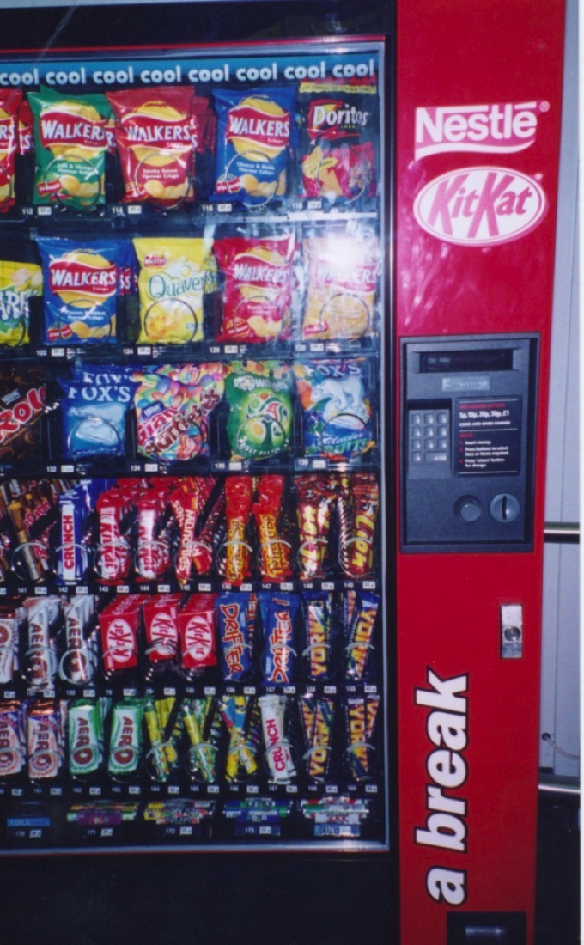
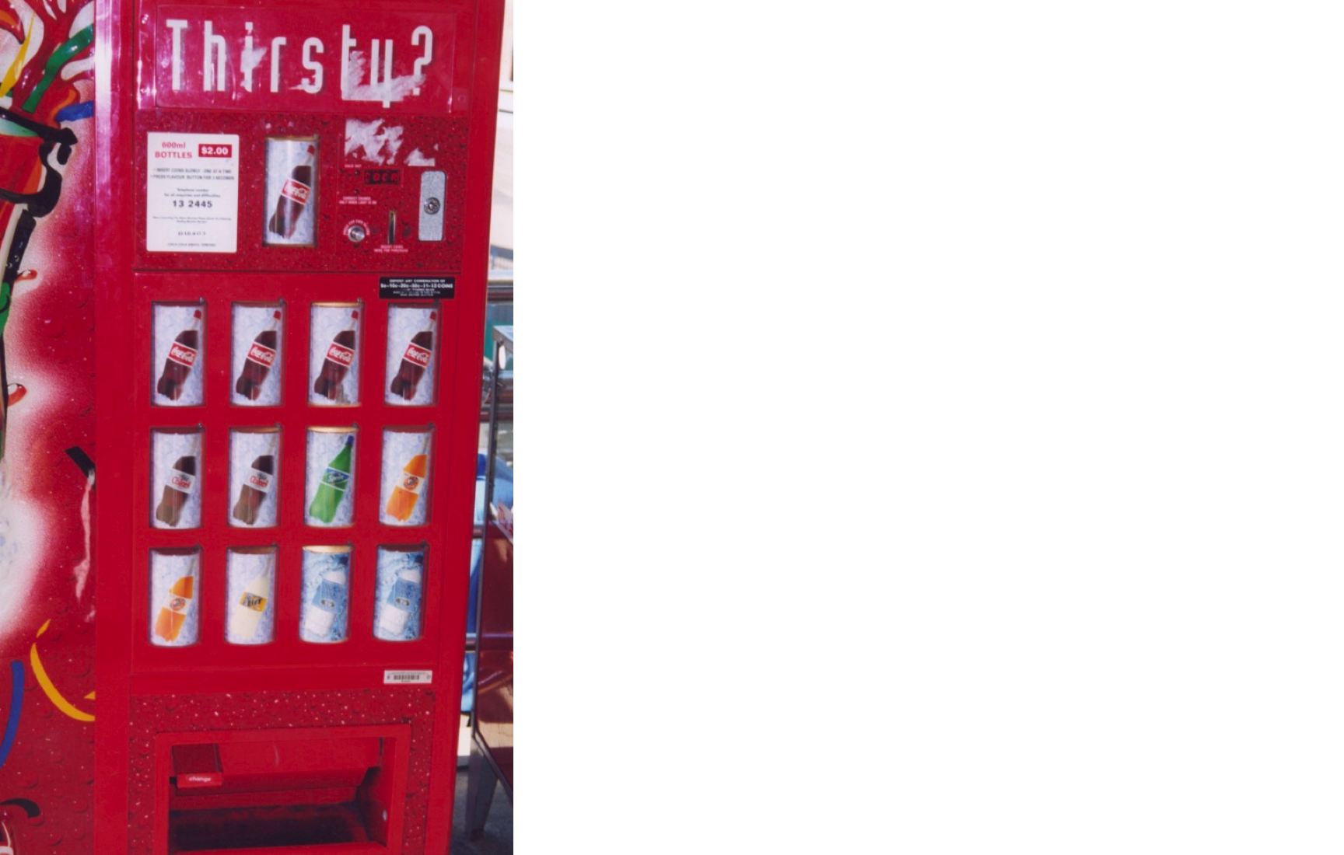
Which is easiest and why?
Notes:
The first vending machine has been designed using simple instructions. There is a small number of drinks to choose from and each is represented by a large button displaying the label of each drink. The user simply has to press one button and this should have the effect of returning the selected drink. The second machine is more complex, offering a wider range of snacks. The trade-off for providing more choices, however, is that the user can no longer instruct the machine by using a simple one-press action but is required to use a more complex process, involving: (i) reading off the code (e.g., C12) under the item chosen, then (ii) keying this into the number pad adjacent to the displayed items, and (iii) checking the price of the selected option and ensuring that the amount of money inserted is the same or greater (depending on whether or not the machine provides change). Problems that can arise from this type of interaction are the customer misreading the code and or miskeying in the code, resulting in the machine not issuing the snack or providing the wrong item.
A better way of designing an interface for a large number of choices of variable cost might be to continue to use direct mapping, but use buttons that show miniature versions of the snacks placed in a large matrix (rather than showing actual versions). This would use the available space at the front of the vending machine more economically. The customer would need only to press the button of the object chosen and put in the correct amount of money. There is less chance of error resulting from pressing the wrong code or keys. The trade-off for the vending company, however, is that the machine is less flexible in terms of which snacks it can sell. If a new product line comes out they will also need to replace part of the physical interface to the machine – which would be costly.
26

Slide 27
2. Conversing
Underlying model of having a conversation with another human
Range from simple voice recognition menu-driven systems to more complex ‘natural language’ dialogs
Examples include timetables, search engines, advice-giving systems, help systems
Also virtual agents, chatbots, toys and pet robots designed to converse with you
Notes:
27

Slide 28
Pros and cons of conversational model
Allows users, especially novices to interact with a system in a way that is familiar to them
can make them feel comfortable, at ease and less scared
Misunderstandings can arise when the system does not know how to parse what the user says
e.g. voice assistants can misunderstand what children say

Slide 30
3. Manipulating
Involves dragging, selecting, opening, closing and zooming actions on virtual objects
Exploit’s users’ knowledge of how they move and manipulate in the physical world
Can involve actions using physical controllers (e.g. Wii) or air gestures (e.g. Kinect) to control the movements of an on screen avatar
Tagged physical objects (e.g. balls) that are manipulated in a physical world result in physical/digital events (e.g. animation)
Notes:
30

Slide 31
Direct Manipulation (DM)
Ben Shneiderman (1983) coined the term DM
3 core properties:
Continuous representation of objects and actions of interest
Physical actions and button pressing instead of issuing commands with complex syntax
Rapid reversible actions with immediate feedback on object of interest
Notes:
31

Slide 32
Benefits of direct manipulation
Novices can learn the basic functionality quickly
Experienced users can work extremely rapidly to carry out a wide range of tasks, even defining new functions
Intermittent users can retain operational concepts over time
Error messages rarely needed
Users can immediately see if their actions are furthering their goals and if not do something else
Users experience less anxiety
Users gain confidence and mastery and feel in control
Notes:
32

Slide 33
Disadvantages of DM
Some people take the metaphor of direct manipulation too literally
Not all tasks can be described by objects and not all actions can be done directly
Some tasks are better achieved through delegating, e.g. spell checking
Can become screen space ‘gobblers’
Moving a cursor using a mouse or touch pad can be slower than pressing function keys to do same actions
Notes:
33

Slide 34
4. Exploring
Involves moving through virtual or physical environments
users can explore aspects of a virtual 3D environment
physical environments can also be embedded with sensors that when detect the presence of someone will trigger digital or physical events to happen
Many examples of virtual environments, including cities, parks, buildings, rooms, and datasets
enable users to fly over them and zoom in and out of different parts

Slide 35
Seeing things larger than life in VR
Reproduced with permission. http://home.comcast.net/~sharov/3d/cave.html

Slide 36
Exploring data in VR
Image courtesy of Kalev Leetaru, National Center for Supercomputing Applications, University of Illinois.

Slide 37
Responding
System takes the initiative to alert user to something that it “thinks” is of interest
Does this by:
detecting the location and/or presence of someone in a vicinity and notifies them on their phone/watch,
what it has learned from their repeated behaviors
Examples:
alerts the user of a nearby coffee bar where some friends are meeting
user’s fitness tracker notifies them of a milestone reached
Automatic system response without any requests made by the user
This type suggested by Christopher Lueg et al. (2018)

Slide 38
Potential cons of system initiated notifications
Can get tiresome or frustrating if too many or the system gets it wrong
What does it do when it gets something wrong?
Apologise?
Allow user to correct the advise or information?

Slide 39
Choosing an interaction type
Direct manipulation is good for ‘doing’ types of tasks, e.g. designing, drawing, flying, driving, sizing windows
Issuing instructions is good for repetitive tasks, e.g. spell-checking, file management
Having a conversation is good for certain services, e.g. finding information, requesting music
Hybrid conceptual models are good for supporting multiple ways of carrying out the same actions
Notes:
39

Slide 40
Difference between interaction types and interface styles
Interaction type:
A description of what the user is doing when interacting with a system, e.g. instructing, talking, browsing or responding
Interface style:
the kind of interface used to support the interaction, e.g. command, menu-based, gesture, voice

Slide 41
Many kinds of interface styles available (see chapter 7)…
Command
Speech
Data-entry
Form fill-in
Query
Graphical
Web
Pen
Augmented reality
Gesture

Slide 42
Other sources
Of conceptual knowledge that are used to inform design and guide research are:
paradigms
visions
theories
models
frameworks

Slide 43
Paradigm
Inspiration for a conceptual model
General approach adopted by a community for carrying out research
shared assumptions, concepts, values, and practices
e.g. desktop, ubiquitous computing, in the wild

Slide 44
Examples of new paradigms in HCI
Ubiquitous computing
Pervasive computing
Wearable computing
Internet of Things

Slide 45
Visions
A driving force that frames research and development
Invites people to imagine what life will be like in 10, 15 or 20 years time
e.g. Apple’s 1987 Knowledge Navigator
Smart Cities, Smart Health
Human-centred AI
Provide concrete scenarios of how society can use the next generation of imagined technologies
Also raise ethical questions, e.g. privacy, trust

Slide 46
Questions raised by tech visions
How to enable people to access and interact with information in their everyday lives
How to design user experiences where there is no obvious user control
How and in what form to provide contextually relevant information to people
How to ensure that information passed around interconnected devices, and objects is secure

Slide 47
Theory
Explanation of a phenomenon
e.g. information processing that explains how the mind, or some aspect of it, is assumed to work
Can help identify factors relevant to the design and evaluation of interactive products
e.g. cognitive, social, and affective
Can be used to predict what users will do with different interfaces

Slide 48
Models
A simplification of an HCI phenomenon
enables designers to predict and evaluate alternative designs
abstracted from a theory coming from a contributing discipline, e.g.
Don Norman’s (1996) model of the seven stages of action
Marc Hassenzahl’s (2010) model of the user experience

Slide 49
Frameworks
Set of interrelated concepts and/or specific questions for ‘what to look for
Provide advice on how to design user experiences
helping designers think about how to conceptualize learning, working, socializing, fun, emotion
Focus on how to design particular kinds of interfaces to evoke certain responses
Come in various forms:
e.g. steps, questions, concepts, challenges, principles, tactics and dimensions

Slide 50
A classic HCI framework
Don Norman’s (1988) framework of the relationship between the design of a conceptual model and a user’s understanding of it
Consists of three interacting components:
The Designer’s Model
The model the designer has of how the system should work
System Image
How the system actually works, which is portrayed to the user through the interface, manuals, help facilities, and so on
The User’s Model
How the user understands how the system works

Slide 51
Summary
Developing a conceptual model involves:
understanding the problem space
Being clear about your assumptions and claims
specifying how the proposed design will support users
A conceptual model is a high-level description of a product in terms of
what users can do with it and the concepts they need to understand how to interact with it
Interaction types provide a way of thinking about how to support user’s activities
Paradigms, visions, theories, models & frameworks
provide ways of framing design and research

